Slide 1
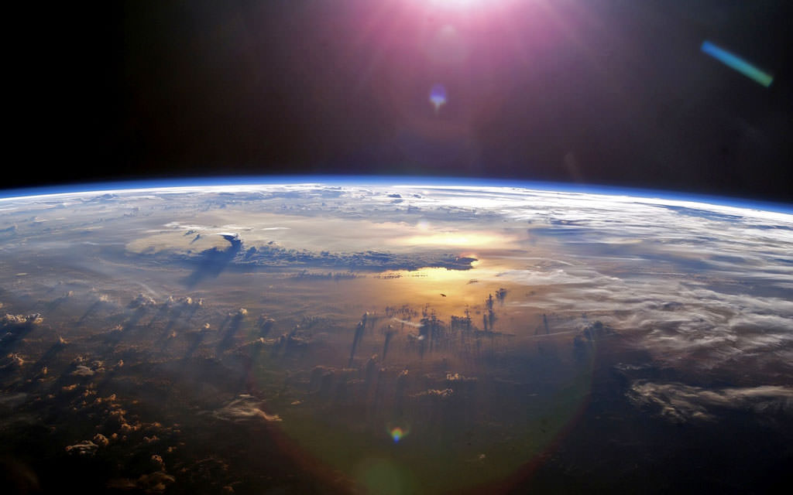

High Altitude Payload Project
Casa Grande Union High School
Near Space Research Team
ASCEND

Slide 2
CGUHS Near Space Research Team
Neal Allado – Programmer/Electrical Elijah Ramirez – Fabrication
Merick Carlisi – Programmer Angel Gonzalez – Power Management
Jonathan Lawson – Programmer Sophia Jorda – Mentor/Science Lead
Elias Razo – CAD model/Electrical Danika Liebhart – Project Management
Aiden Schairer – Fabrication/Electrical
.

Slide 3
Mission Statement
We will design, construct, test, and fly a sensor payload to gather data about the atmosphere.

Slide 4
Science Question
The Earth’s Ozone layer protects life from harmful Ultraviolet Radiation from the Sun.
How much UV light does the ozone layer protect us from? How does the intensity of UV light change over time as altitude is increased?

Slide 5
Objectives
- To record and interpret data from the following sensors as the payload rose through the atmosphere:
  Ultraviolet Radiation
  O₃ (ozone)
  O₂ (oxygen)
  BMP280 (Temperature, humidity, and pressure)
- To take a photograph of the curvature of the Earth.

Slide 6

Timeline
01.07.22
01.12.22
02.18.22
02.20.22
January -
Create Bill of Material
Create Gantt chart
February -
Get Parts in
Create enclosure
Start working on O2 and O3 sensors
March -
Finish up O2 and O3 sensors
Begin on UV sensors
Test camera
Start installing
April -
Final Testing
Launch
Results & Analysis
03.12.22
03.15.22
04.01.22
04.02.22

Slide 7
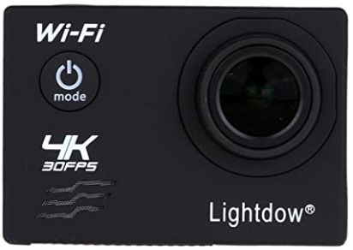
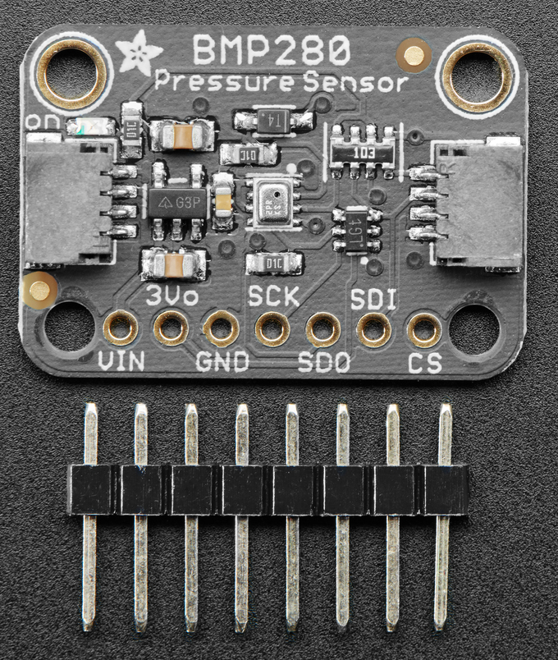
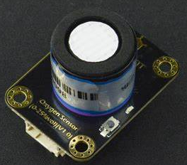
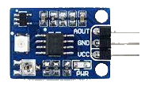
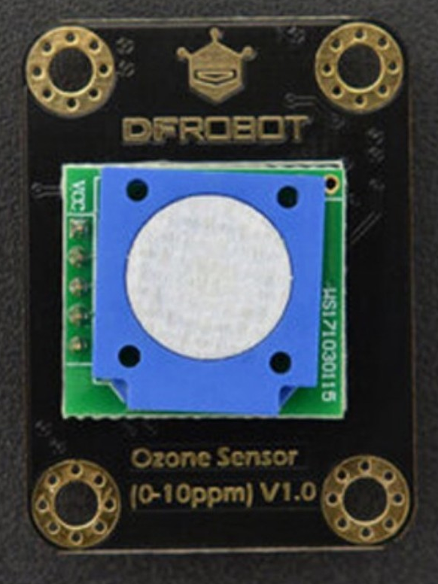
Sensors
Lightdow 4K Action Camera
Waveshare 9537 UV Sensor Response spectrum: 200nm-370nm
BMP 280 – Pressure, Humidity, and Temperature Sensor
DFRobot I²C Oxygen Sensor
DFRobot I²C Ozone Sensor

Slide 8
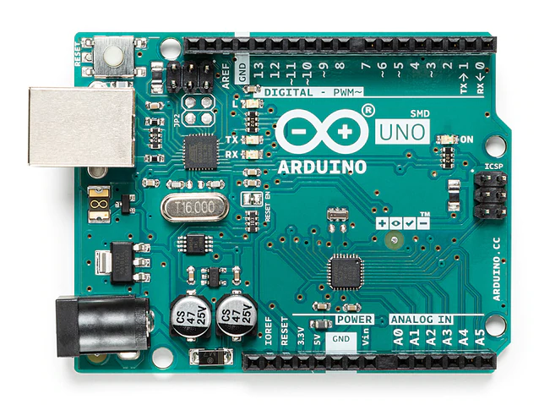
Controller Board
Arduino Uno Rev3 SMD
ATmega328P Microcontroller
Clock Speed: 16 MHz
32 KB Flash Memory
Weight: 25g
Programmed using the Arduino IDE

Slide 9
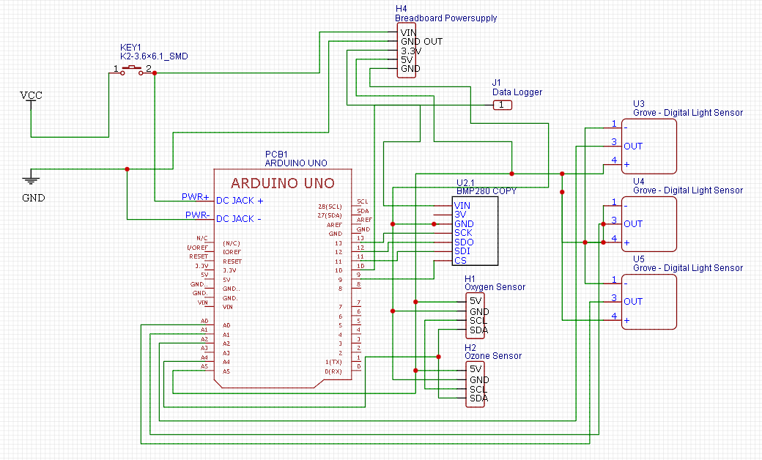
Power Distribution System

Slide 10
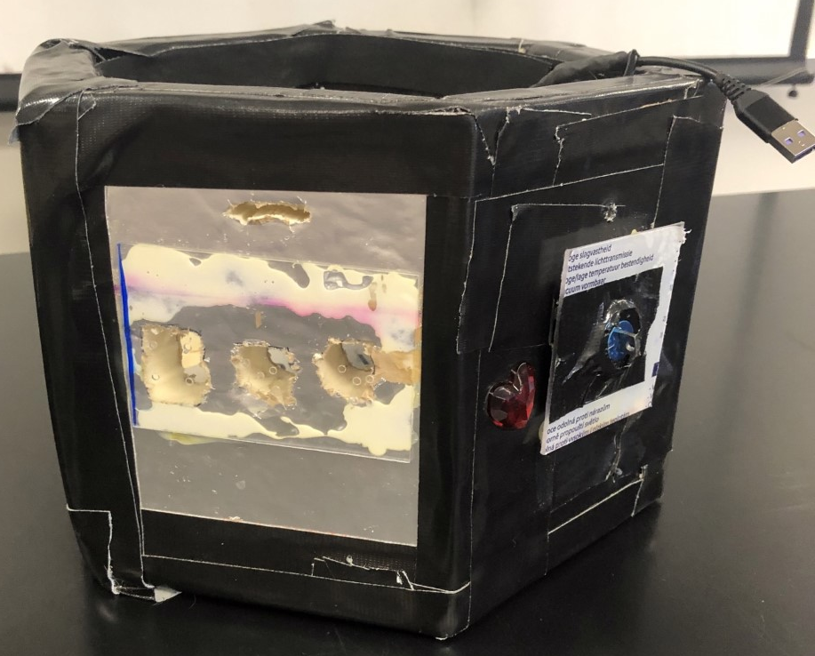
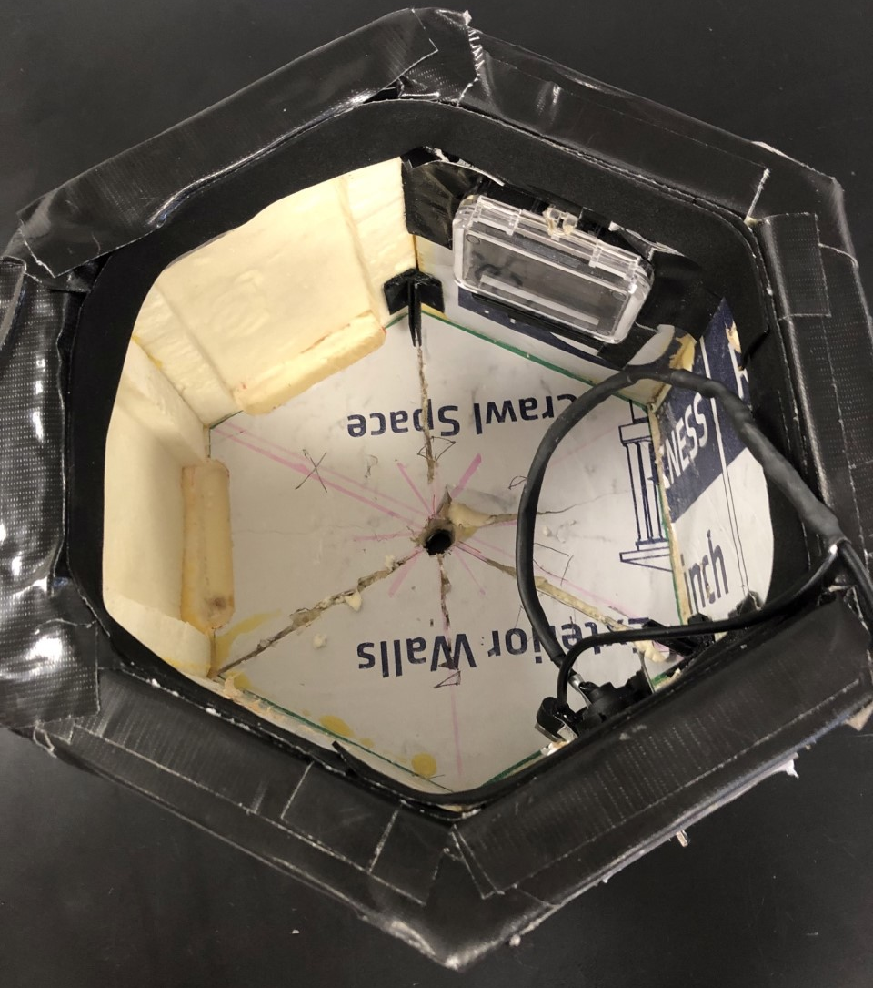
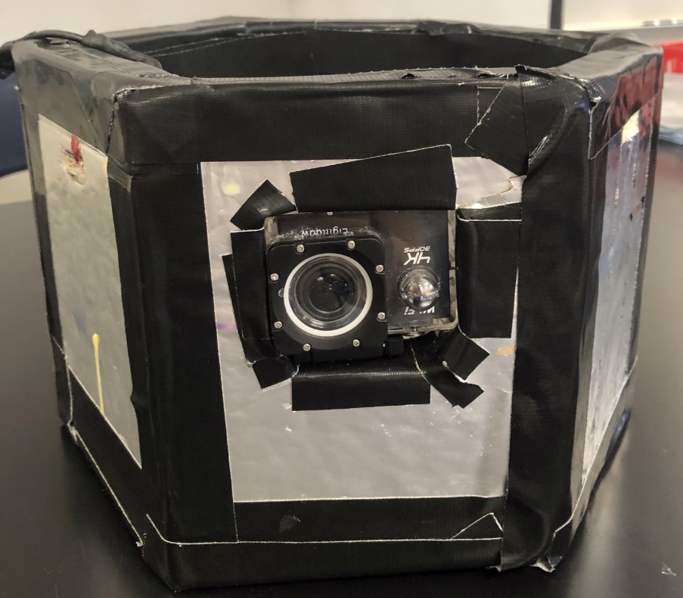
Enclosure
Sika Rmax Pro Select R-Matte foam insulation board, 1” thickness, R-13
Interior is divided into 3 bays by removable Lexan panels.
  Power System
  Controllers and Sensors
  Camera
Top is covered by a hexagonal Lexan panel and closed-cell foam tape isolator.

Slide 11
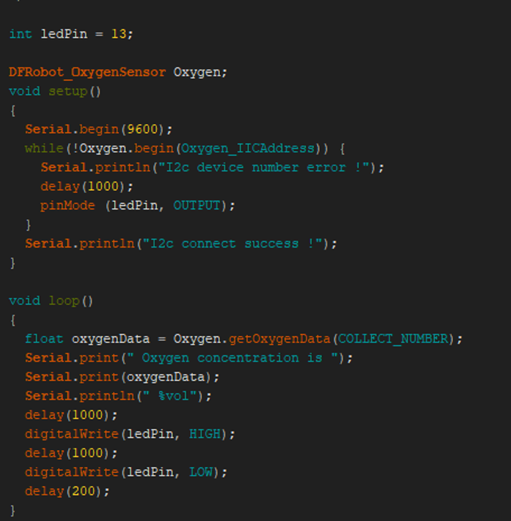
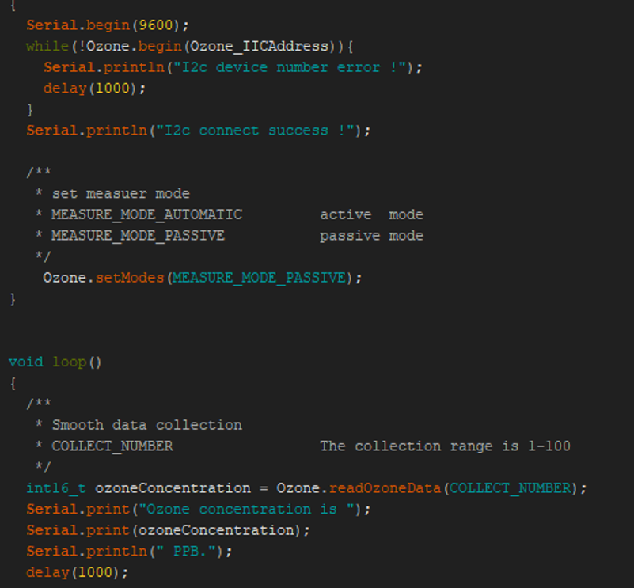
Programming

Slide 12
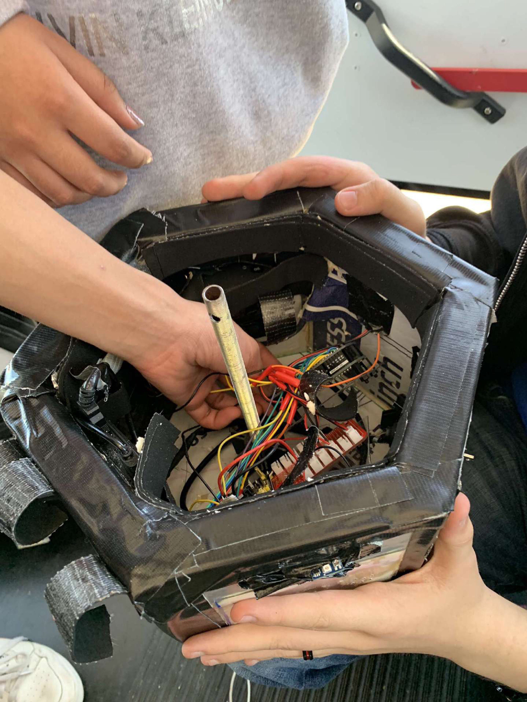
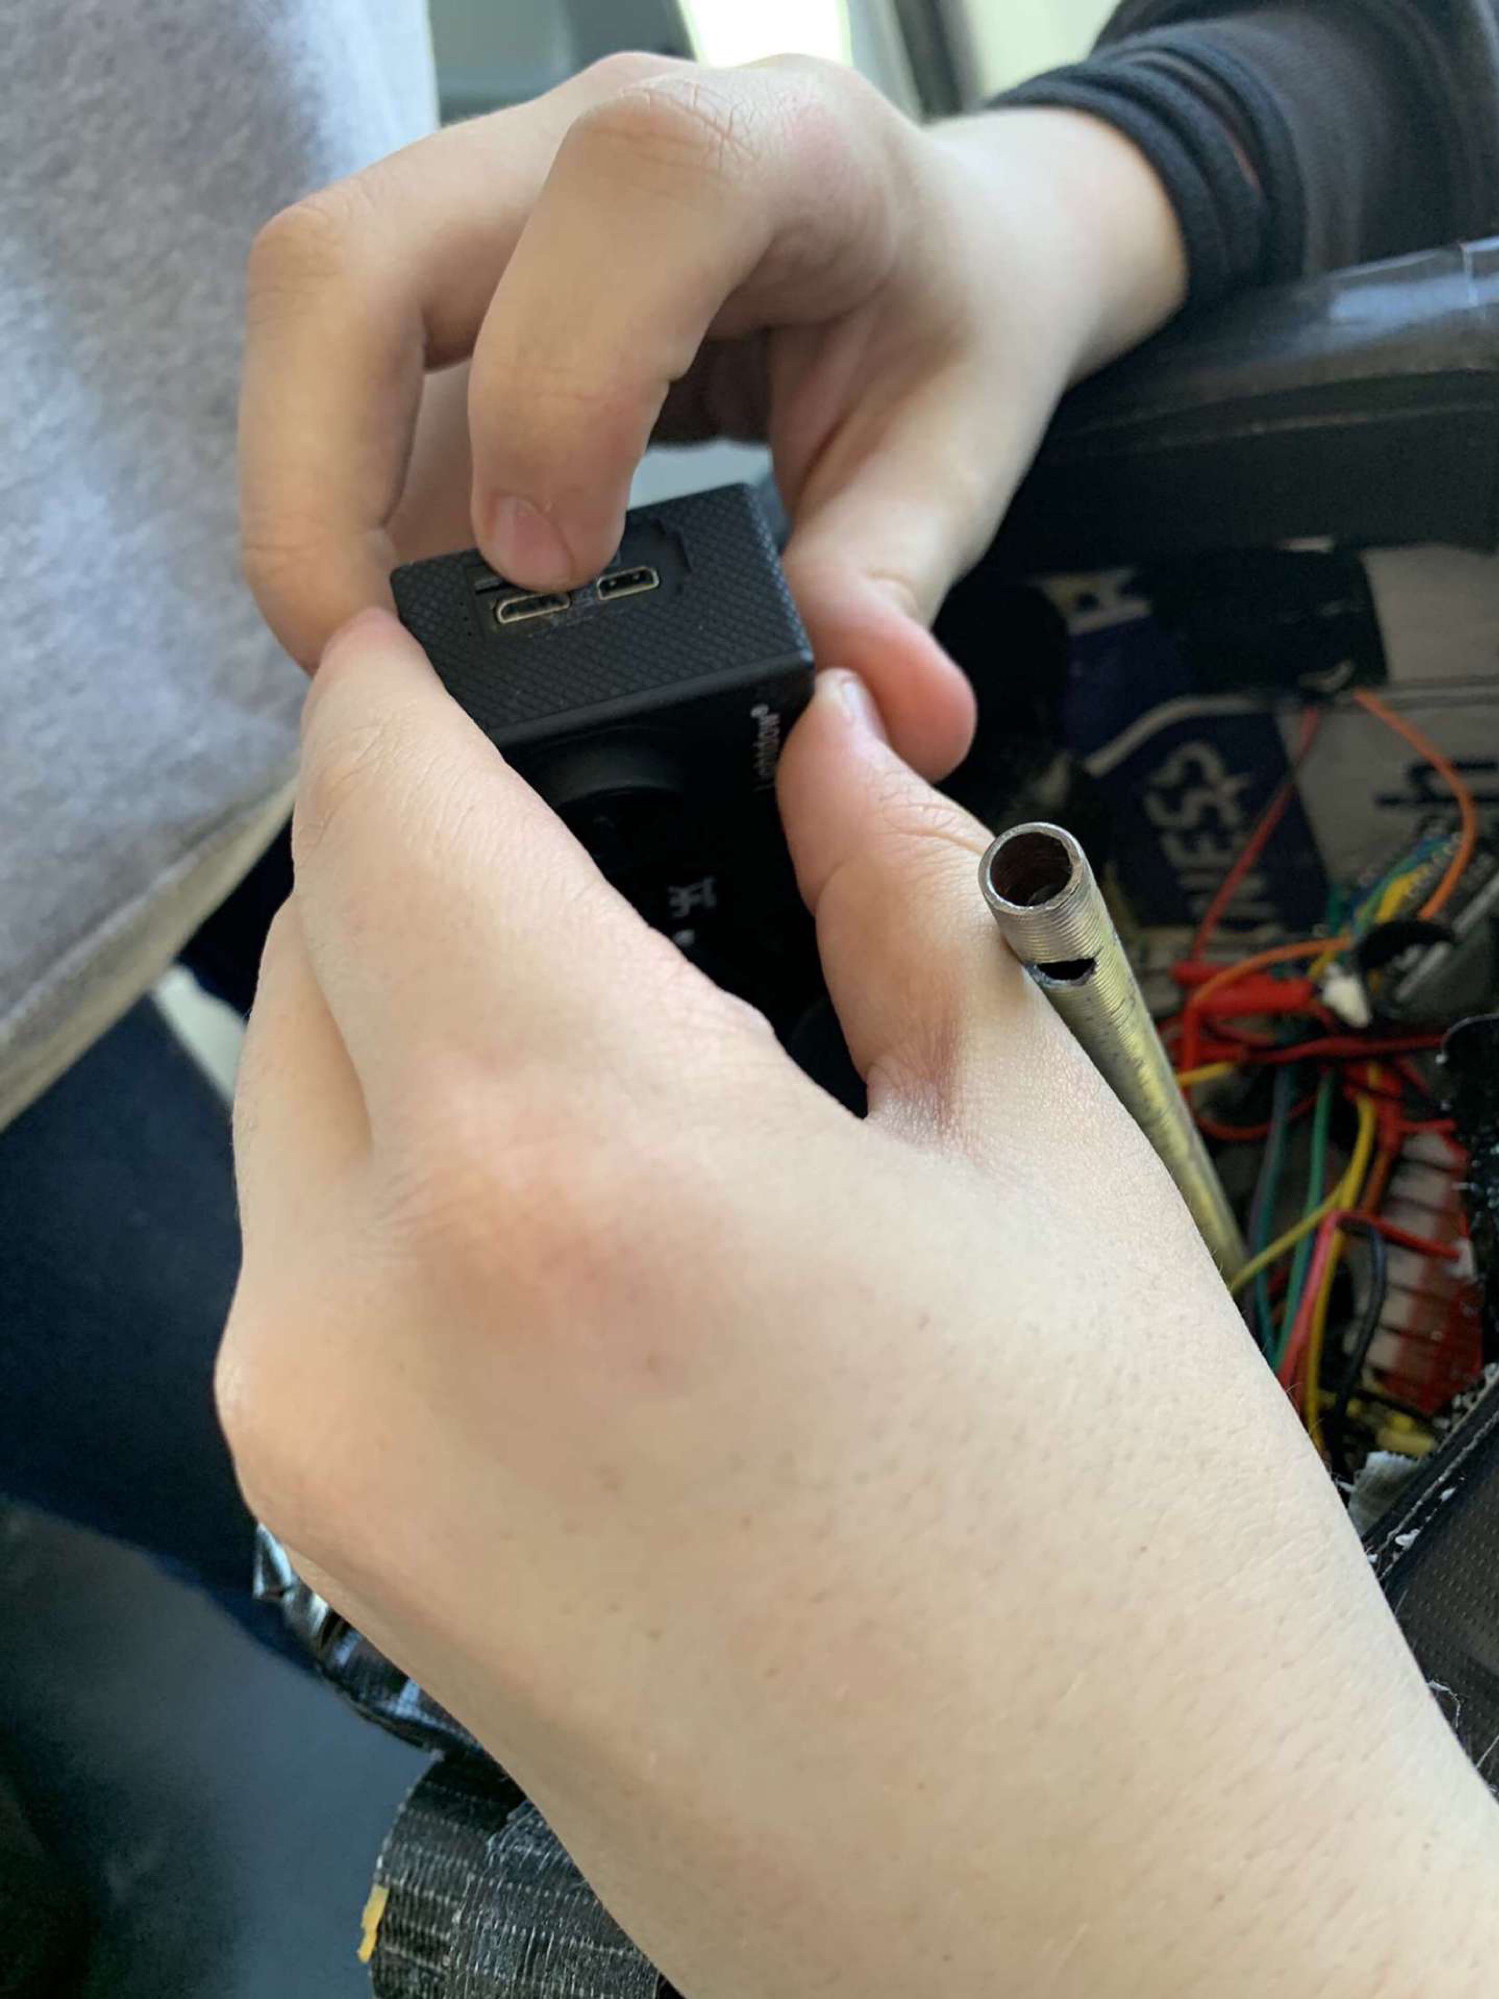
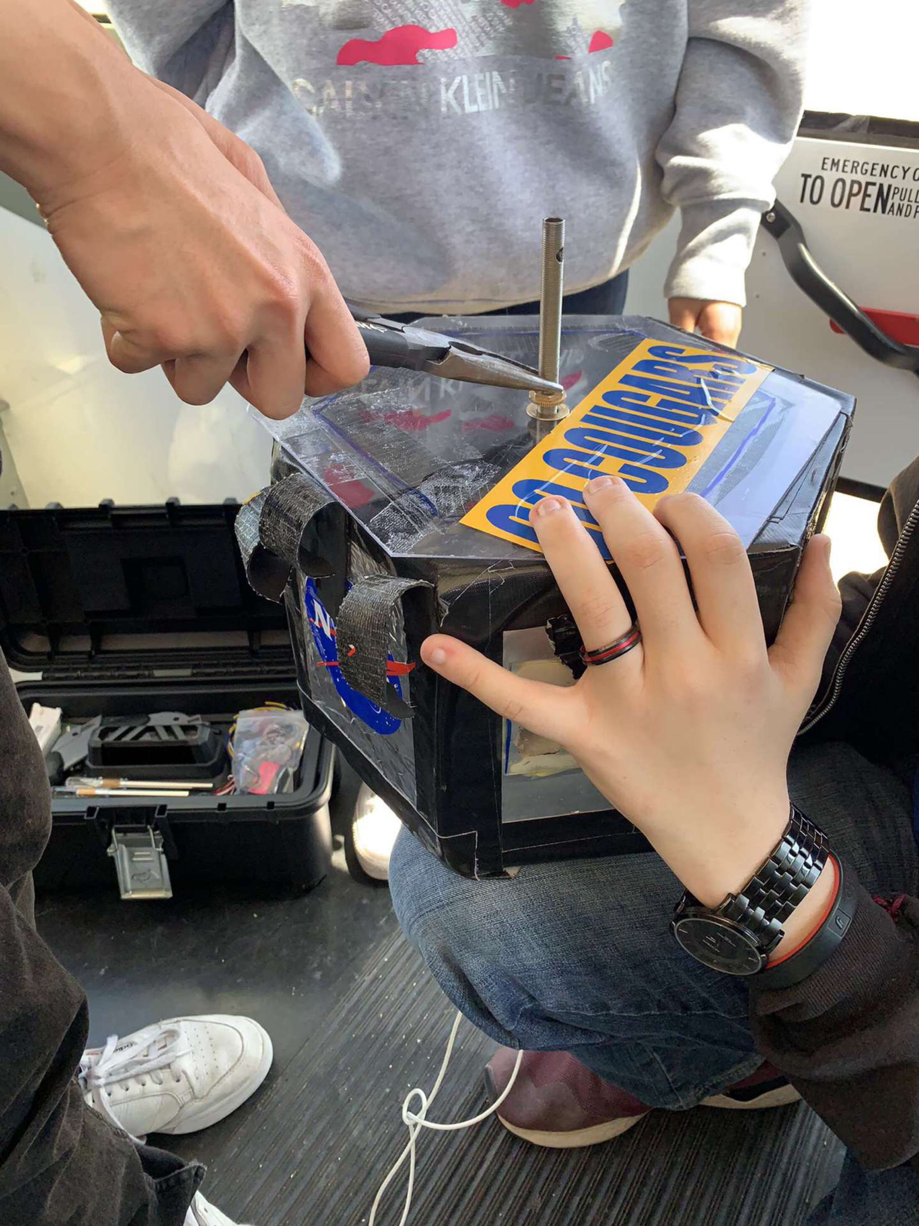
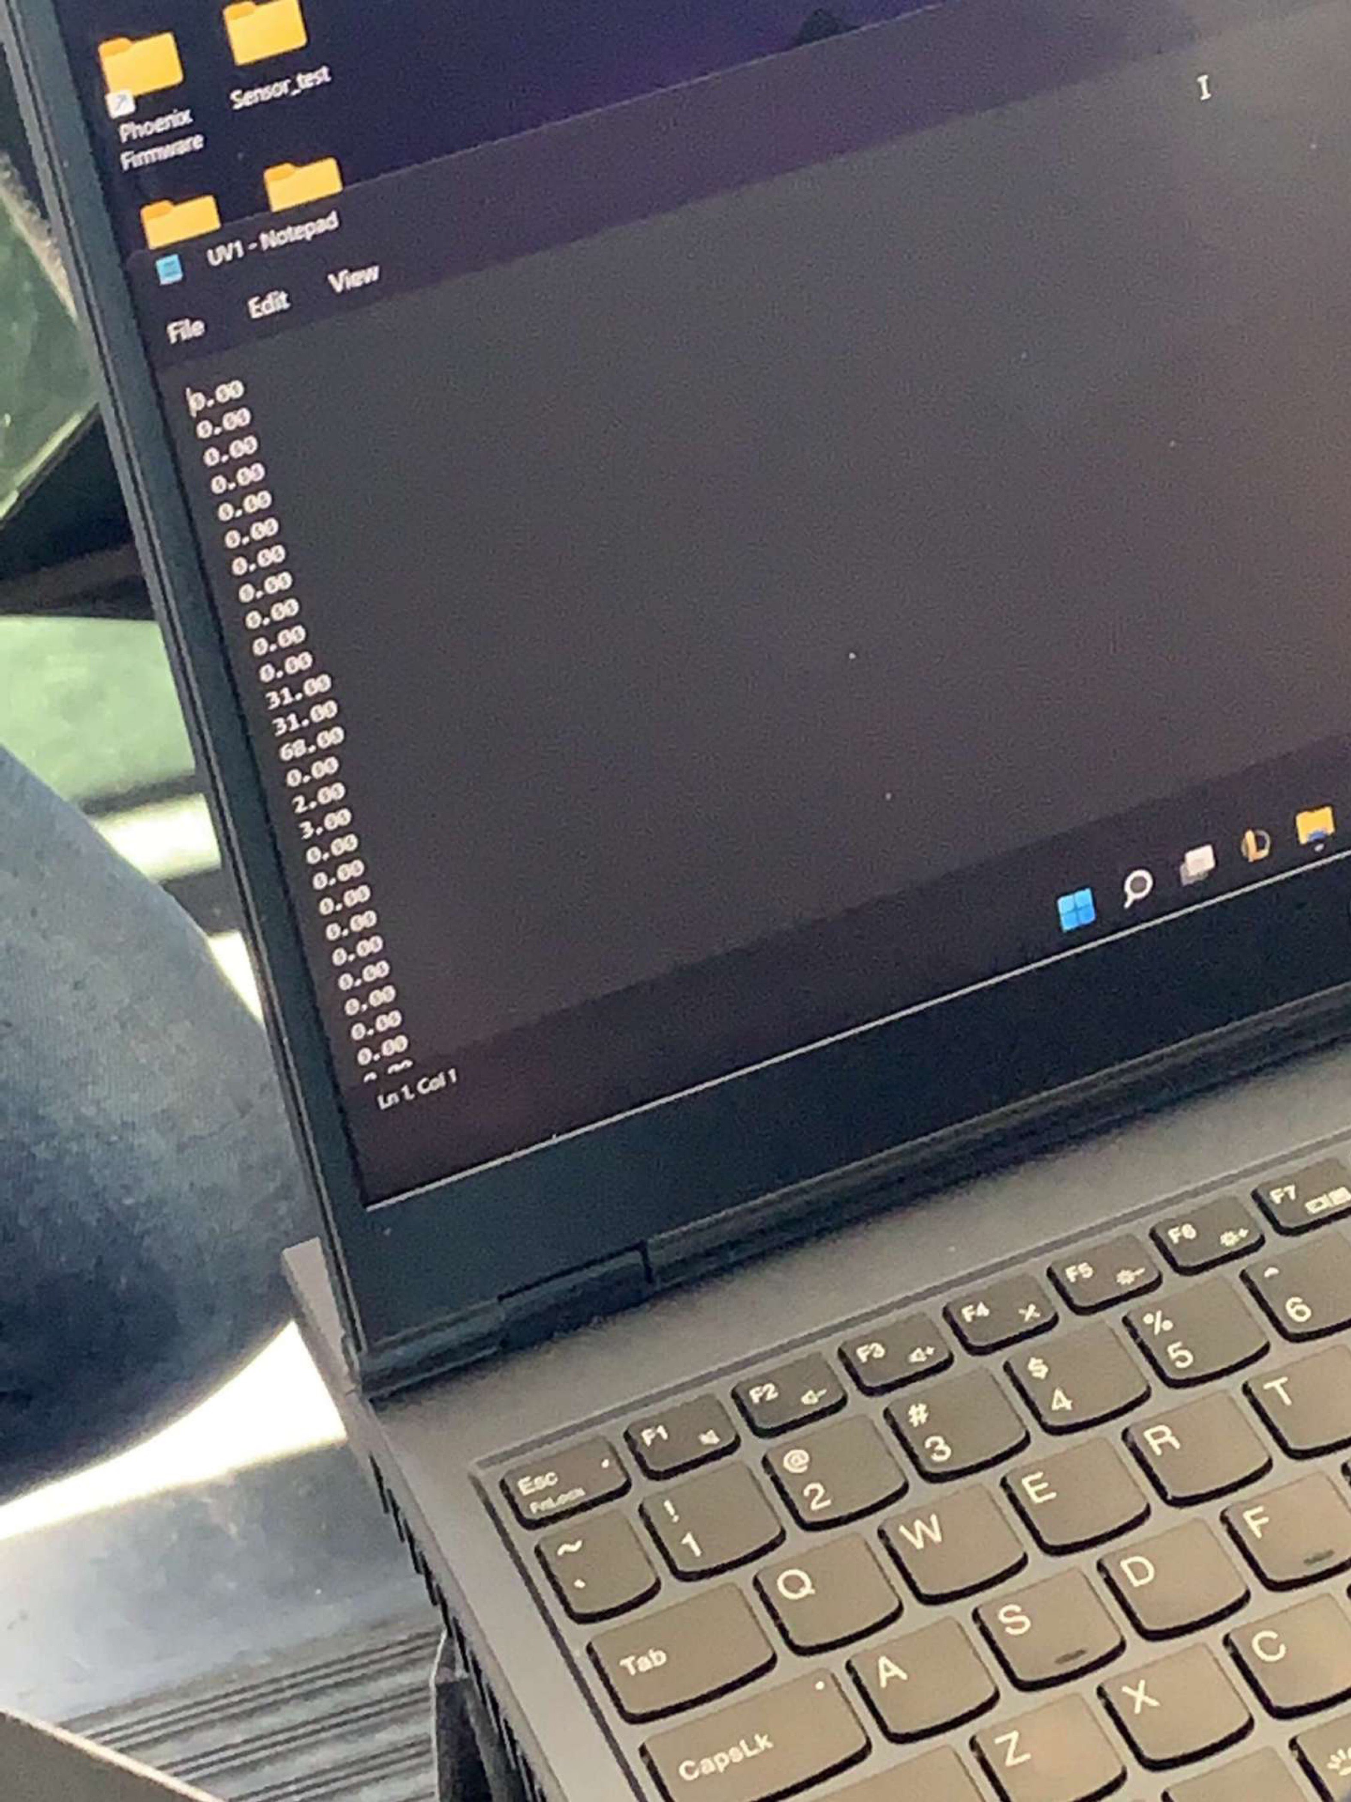
Recovery Story

Slide 13
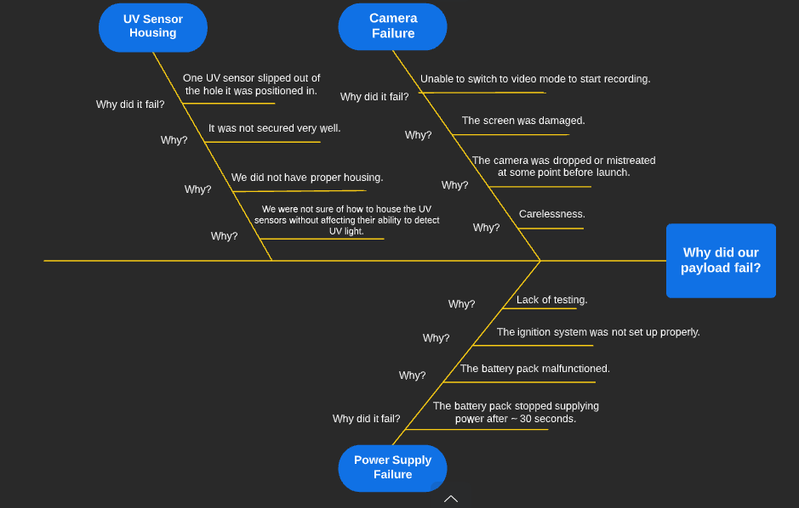
Fishbone Method

Slide 14
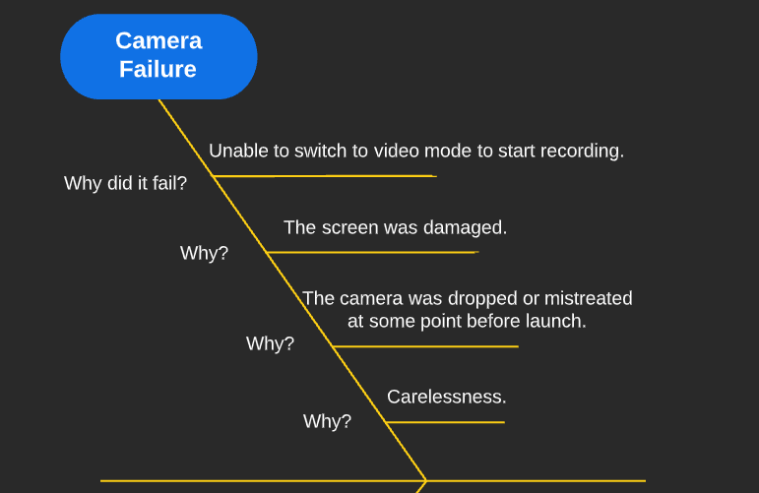

Slide 15
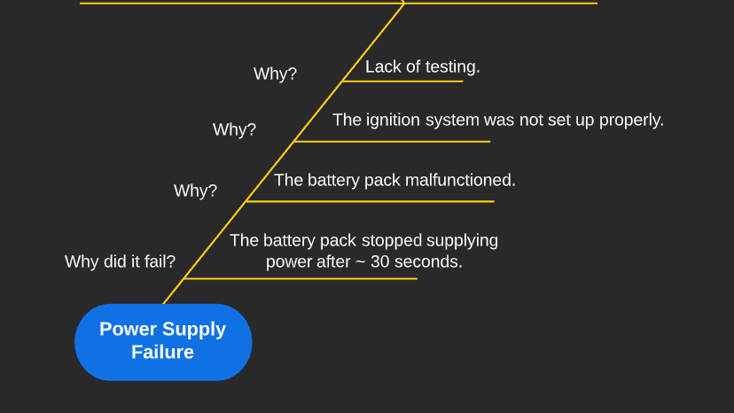

Slide 16
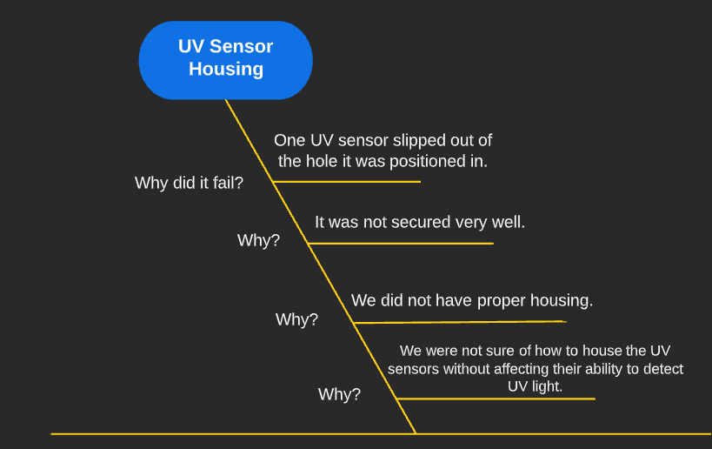

Slide 17
Appreciation
John Morris
CGUHS
Michelle Coe
University of Arizona
Ann Marie Condes
Pima Community College

